Slide 1
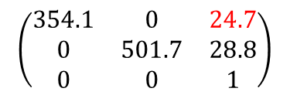
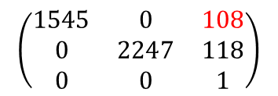
Geo cal result
For raw images,
$$\left(\begin{matrix}354.1 & 0 & 24.7 \\ 0 & 501.7 & 28.8 \\ 0 & 0 & 1\end{matrix}\right)$$
intrinsic:
Radial distortion parameters:
[k1, k2, p1, p2, k3] = $\left[−4.7, −52, 0.032, 1.1, 240\right]$
For four times upscaled images,
$$\left(\begin{matrix}1545 & 0 & 108 \\ 0 & 2247 & 118 \\ 0 & 0 & 1\end{matrix}\right)$$
intrinsic:
Radial distortion parameters:
[k1, k2, p1, p2, k3] = $\left[−6.1, −60, 0.028, 1.13, 330\right]$
For both case, $u_{c}$(or, $c_{x}$) is uncertain. It is expected to be fixed after active-align is completed.

Slide 2







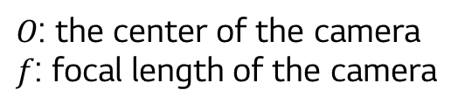


Definition of intrinsic parameter
$$\left(\frac{X}{Z},\frac{Y}{Z},1\right)≡\left(\frac{X}{Z},\frac{Y}{Z}\right)$$
a projected point
$$\left(\frac{fX}{Z},\frac{fY}{Z},f\right)$$
$$P$$
$$\left(X,Y,Z\right)$$
$$o$$
$$1$$
$$f$$
camera center
$O$: the center of the camera
$f$: focal length of the camera
$$y$$
$$x$$
normalized
image plane
image plane

Slide 3
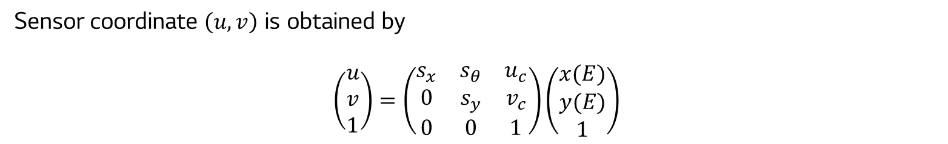
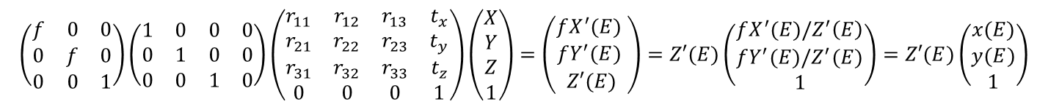
Definition of intrinsic parameter
The projection to the normalized image plane is,
$$\left(\begin{matrix}f & 0 & 0 \\ 0 & f & 0 \\ 0 & 0 & 1\end{matrix}\right)\left(\begin{matrix}1 & 0 & 0 & 0 \\ 0 & 1 & 0 & 0 \\ 0 & 0 & 1 & 0\end{matrix}\right)\left(\begin{matrix}r_{11} & r_{12} & r_{13} & t_{x} \\ r_{21} & r_{22} & r_{23} & t_{y} \\ r_{31} & r_{32} & r_{33} & t_{z} \\ 0 & 0 & 0 & 1\end{matrix}\right)\left(\begin{matrix}X \\ Y \\ Z \\ 1\end{matrix}\right)=\left(\begin{matrix}fX^{′}(E) \\ fY^{′}(E) \\ Z′(E)\end{matrix}\right)=Z′(E)\left(\begin{matrix}fX^{′}(E)/Z^{′}\left(E\right) \\ fY^{′}(E)/Z^{′}(E) \\ 1\end{matrix}\right)=Z′(E)\left(\begin{matrix}x(E) \\ y(E) \\ 1\end{matrix}\right)$$
where $E$ denotes the error and $X^{′},Y^{′},$ and $Z′$are the function of error.
Error is due to
the reduction to pinhole modeling.
Lens defects.
Measurement errors.
Sensor coordinate $\left(u,v\right)$ is obtained by
$$\left(\begin{matrix}u \\ v \\ 1\end{matrix}\right)=\left(\begin{matrix}s_{x} & s_{θ} & u_{c} \\ 0 & s_{y} & v_{c} \\ 0 & 0 & 1\end{matrix}\right)\left(\begin{matrix}x(E) \\ y(E) \\ 1\end{matrix}\right)$$

Slide 4
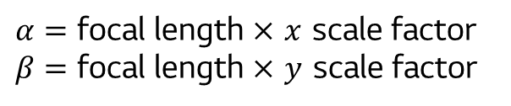
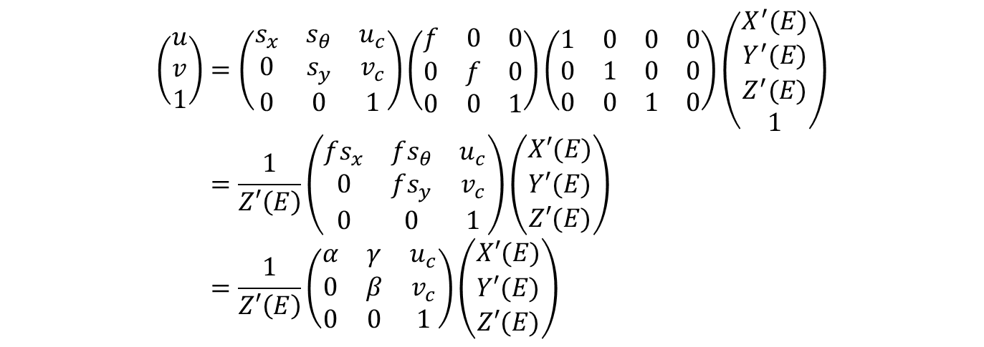
Definition of intrinsic parameter
In summary,
$$\left(\begin{matrix}u \\ v \\ 1\end{matrix}\right)=\left(\begin{matrix}s_{x} & s_{θ} & u_{c} \\ 0 & s_{y} & v_{c} \\ 0 & 0 & 1\end{matrix}\right)\left(\begin{matrix}f & 0 & 0 \\ 0 & f & 0 \\ 0 & 0 & 1\end{matrix}\right)\left(\begin{matrix}1 & 0 & 0 & 0 \\ 0 & 1 & 0 & 0 \\ 0 & 0 & 1 & 0\end{matrix}\right)\left(\begin{matrix}X^{′}(E) \\ Y^{′}(E) \\ Z^{′}(E) \\ 1\end{matrix}\right) \\ =\frac{1}{Z′\left(E\right)}\left(\begin{matrix}fs_{x} & fs_{θ} & u_{c} \\ 0 & fs_{y} & v_{c} \\ 0 & 0 & 1\end{matrix}\right)\left(\begin{matrix}X′(E) \\ Y′(E) \\ Z′(E)\end{matrix}\right) \\ =\frac{1}{Z′\left(E\right)}\left(\begin{matrix}α & γ & u_{c} \\ 0 & β & v_{c} \\ 0 & 0 & 1\end{matrix}\right)\left(\begin{matrix}X′(E) \\ Y′(E) \\ Z′(E)\end{matrix}\right)$$
$α=$ focal length $×$ $x$ scale factor
$β=$ focal length $×$ $y$ scale factor
Note: Scale factors are arbitrary value that depends on the experiment environments.
There is no reason for $α$ or $β$ to be equal to the focal length.

